Slide 1

Gym Crowd Monitoring
Focus Area: Social Impact
Notes:
devan

Slide 2

Team Members and Roles
Huzaifah: Project Leader
Devan: Project Manager
Electra: Presentation Manager
Everyone: Market Research
Everyone: Financial Research/Analysis
Notes:
devan

Slide 3


Elevator Pitch
Have you ever been to the gym only to see your worst nightmare?
With this new Crowd monitoring device you will be able to check the amount of people occupying a gym of their choice.
No more nervous looks, best of all, never having to waste your time by leaving for the gym during crowded hours!
Not convinced? Our app even allows you to track all your stats through the year! We all have heard of spotify wrapped…. But you've never heard of reps wrapped!
Notes:
devan

Slide 4
Elevator Pitch
Have you ever been to the gym only to see your worst nightmare?
With this new Crowd monitoring device you will be able to check the amount of people occupying a gym of their choice.
No more nervous looks, best of all, never having to waste your time by leaving for the gym during crowded hours!
Not convinced? Our app even allows you to track all your stats through the year! We all have heard of spotify wrapped…. But you've never heard of reps wrapped!
Notes:
devan

Slide 5
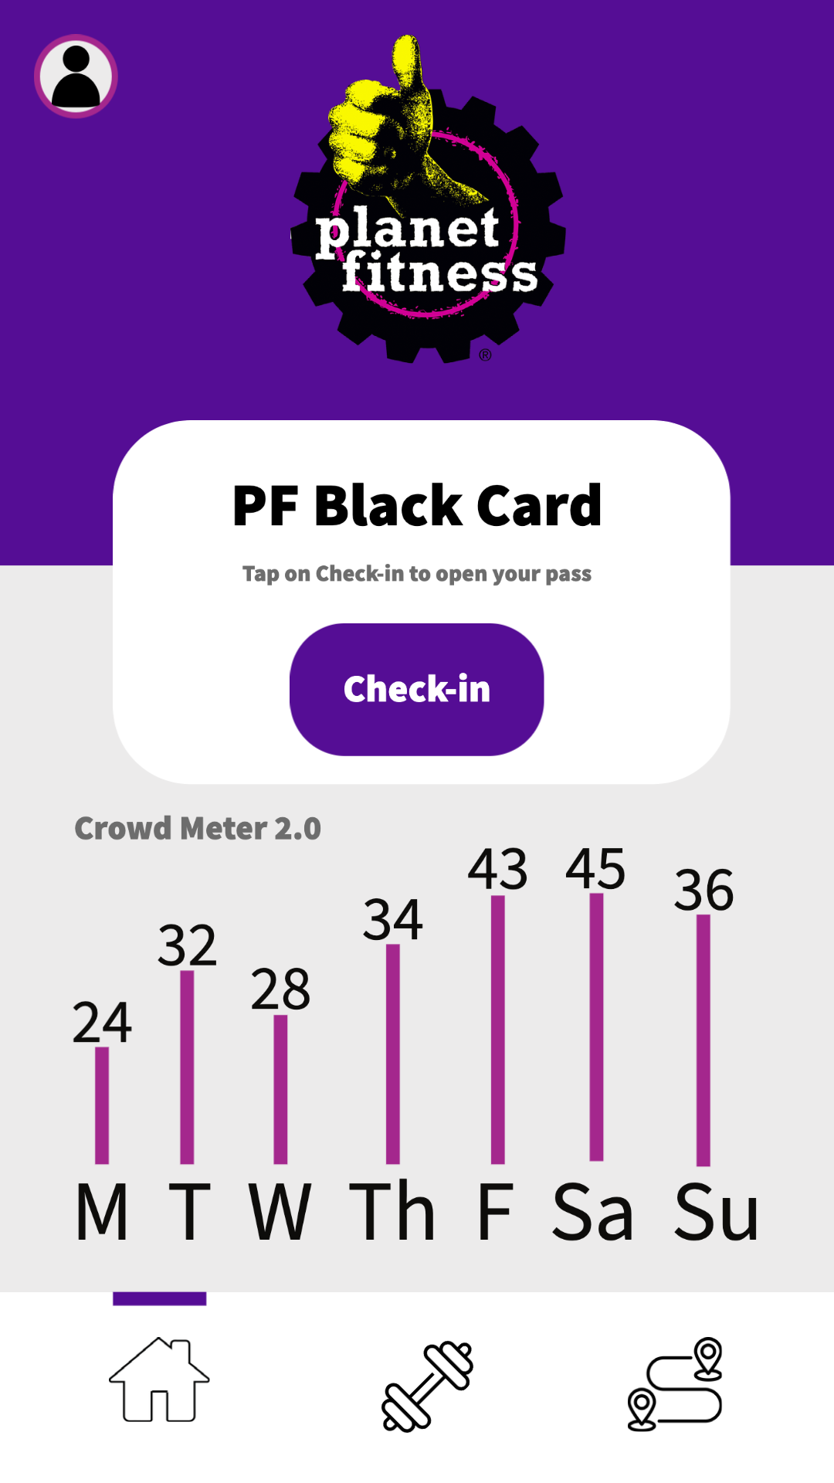
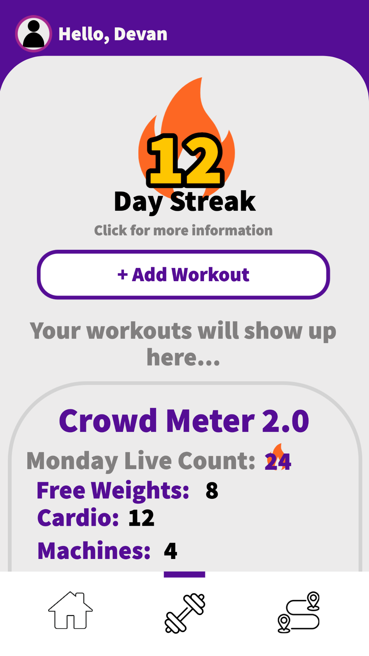
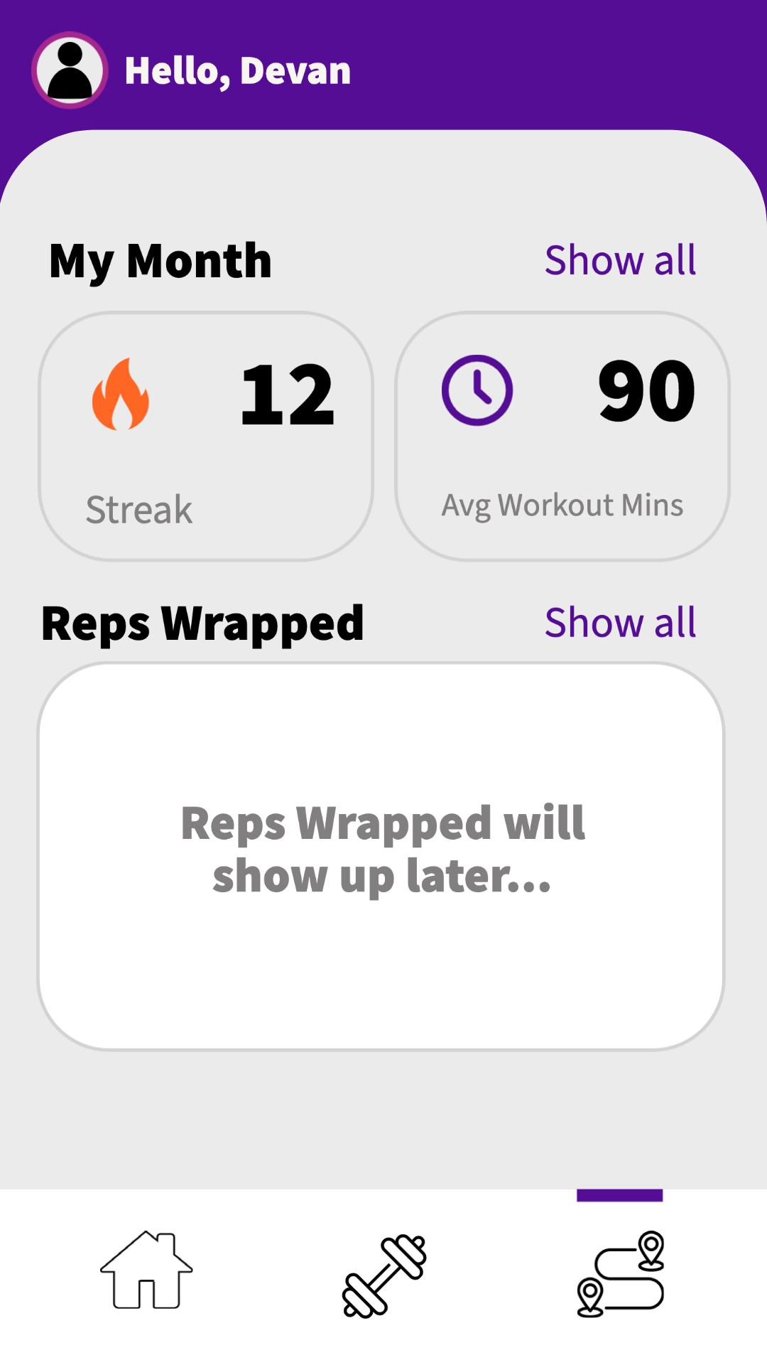
High-Fidelity UX Design
Notes:
Devan

Slide 6
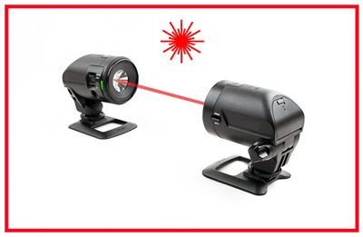
High-Fidelity Prototype
Notes:
zazi

Slide 7

20 inches apart
Notes:
zazi

Slide 8
20 inches apart
Counter Updates
Notes:
zazi

Slide 9
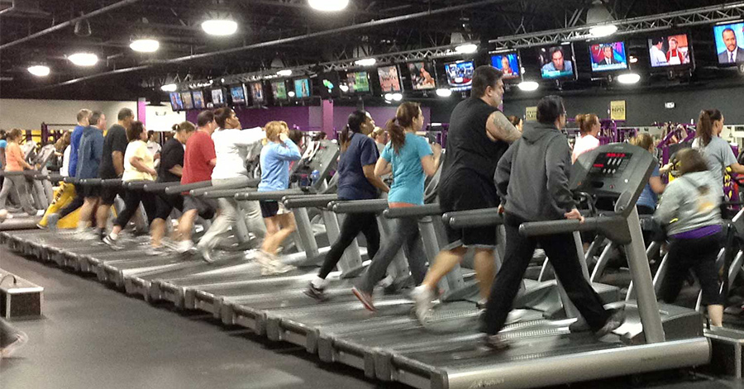

Project Description
Enhancing the “Crowd Meter” feature in the planet fitness application to enable users to track the number of people on a real time basis.
Notes:
zazi

Slide 10
Summary Impact Changes
Stage 2
Updated our Gantt chart
Adjusted our scope by setting geographical boundaries
Stage 3
Updated Gantt chart to include dependencies
Added market supporting detail, which helped us to have better design for our low fidelity prototype
Added Swot Analysis Conclusion
Added Magic Quadrant and Conclusion
Adjusted IRR % which led to quicker break even
Stage 4
Decreasing Working Capital days caused a decrease in Total Cash Outflow which positively impacted our Internal Rate of Return to 30.75%!
Added Financial Spending + Initial Investment details for insight
Notes:
zazi

Slide 11
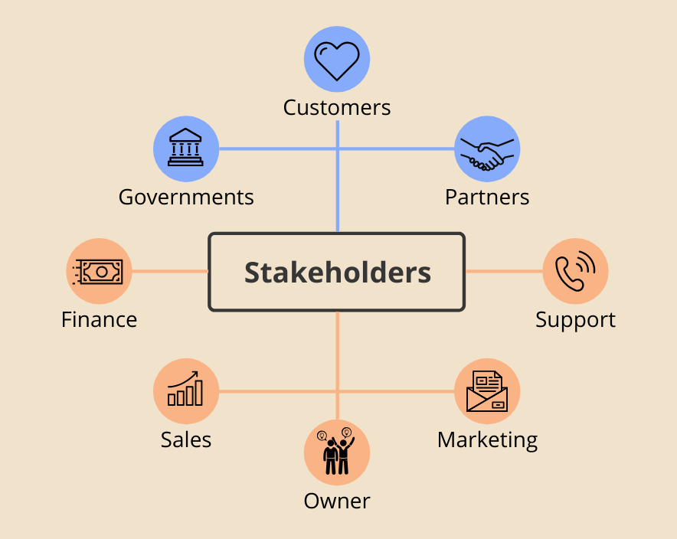
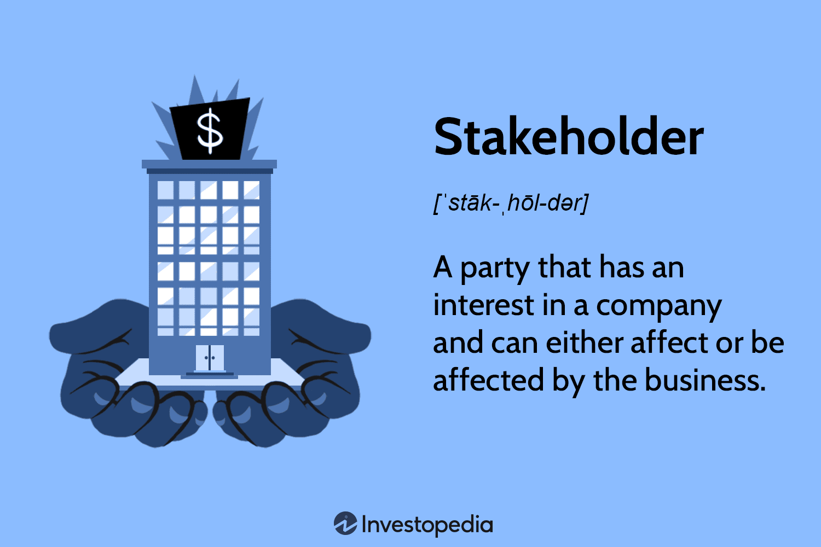
Stakeholders
Planet Fitness
Promise of an increase in profit
Gym managers
Impacts all members
Notes:
electra

Slide 12

Customers/Target Audience
People who go to the gym!
Big Companies
Notes:
electra

Slide 13

In-Scope
Monitoring the number of people in a gym or fitness center at a given time.
This monitoring can be done using our high fidelity prototype
Provide valuable insights into gym usage patterns and help improve overall gym operations.
Essex, Middlesex, Camden counties
3 out of 21 counties is a valid test run
Notes:
zazi

Slide 14
Out-Scope
Planet Fitness has over 2400 locations, and we cannot reach all of them for this project. So we will be limiting to a certain number of clubs that are in-scope within predetermined geographical boundaries.
Data stored could be used for other purposes
Notes:
zazi

Slide 15
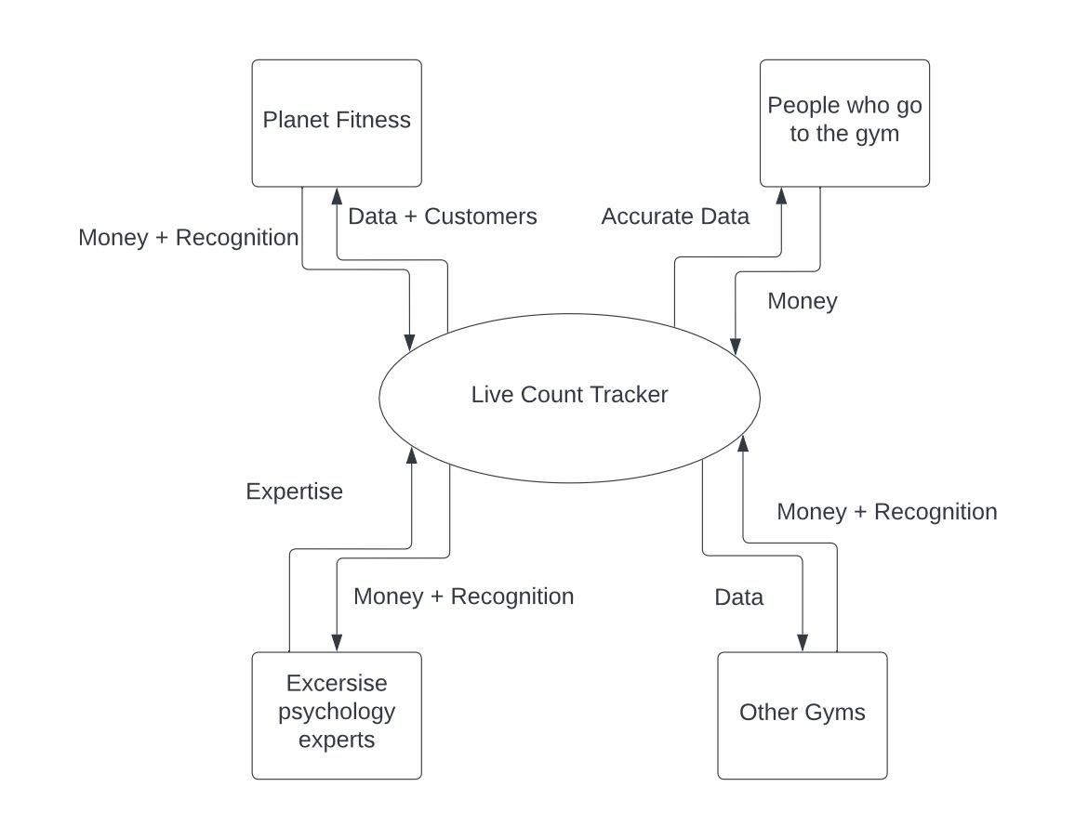
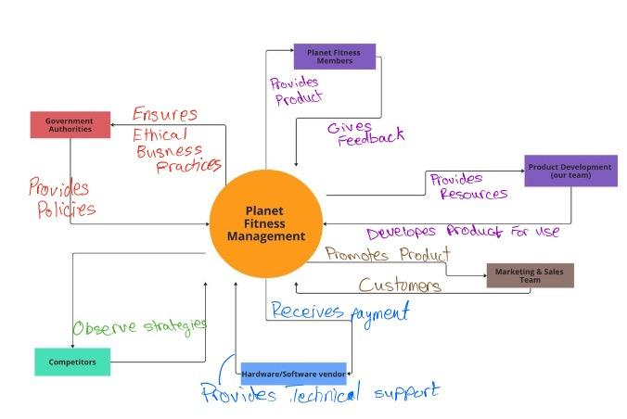
Context Diagram
Notes:
electra

Slide 16
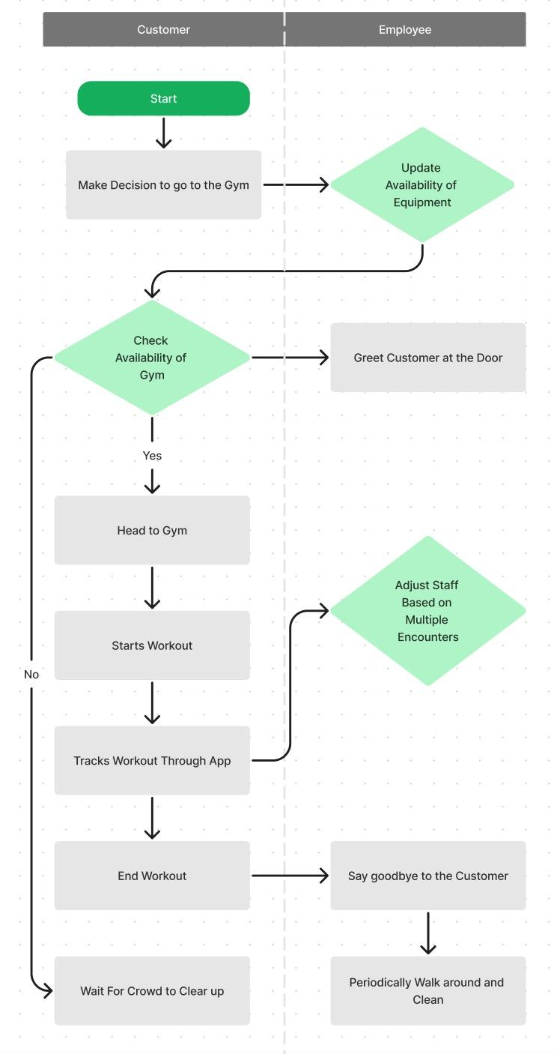
Cross Functional Diagram
Notes:
devan

Slide 17

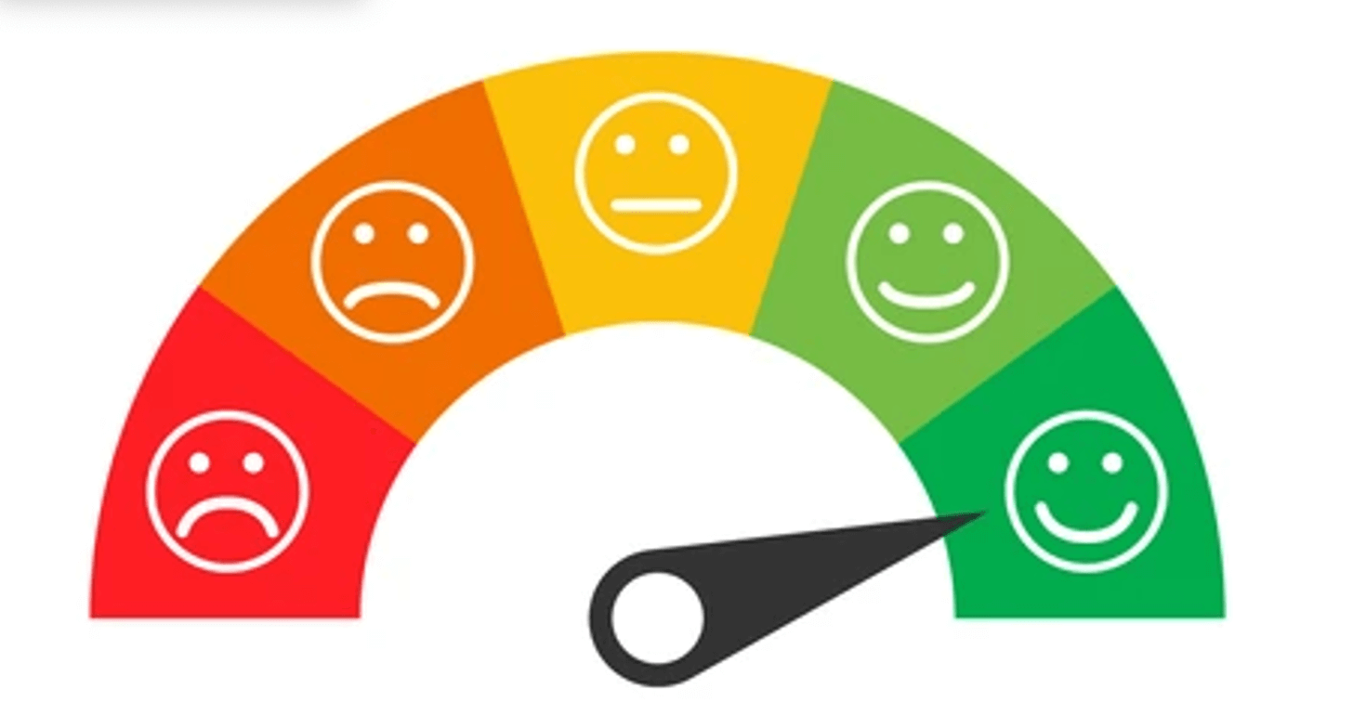
Secondary Research Summary
Attendance Patterns | Customer Satisfaction | Gym Behaviour | Individuals’ Fitness Satisfaction
Demographic Behavioral and situational factors | Quality of facilities Cleanliness Equipment availability Staff competence Social atmosphere | Stage of change Specific needs Social context Environmental factors | Demands of activities Individual's goals
Notes:
electra

Slide 18
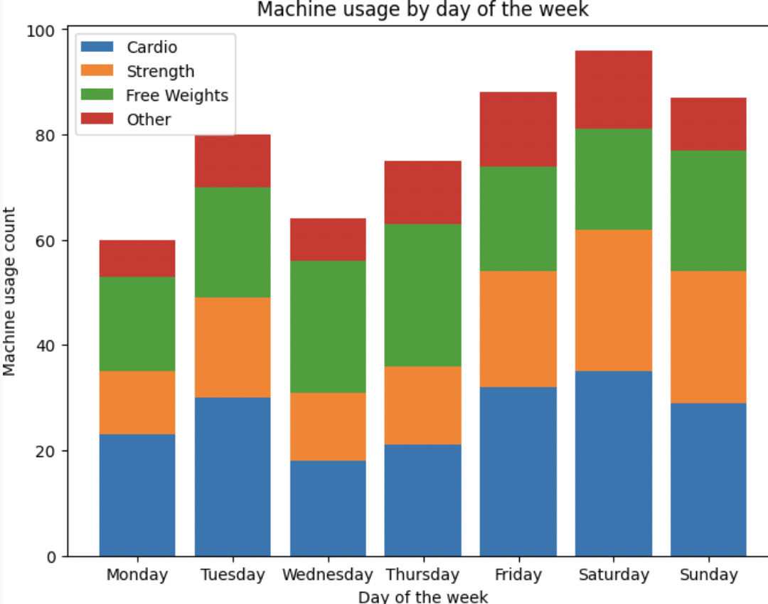
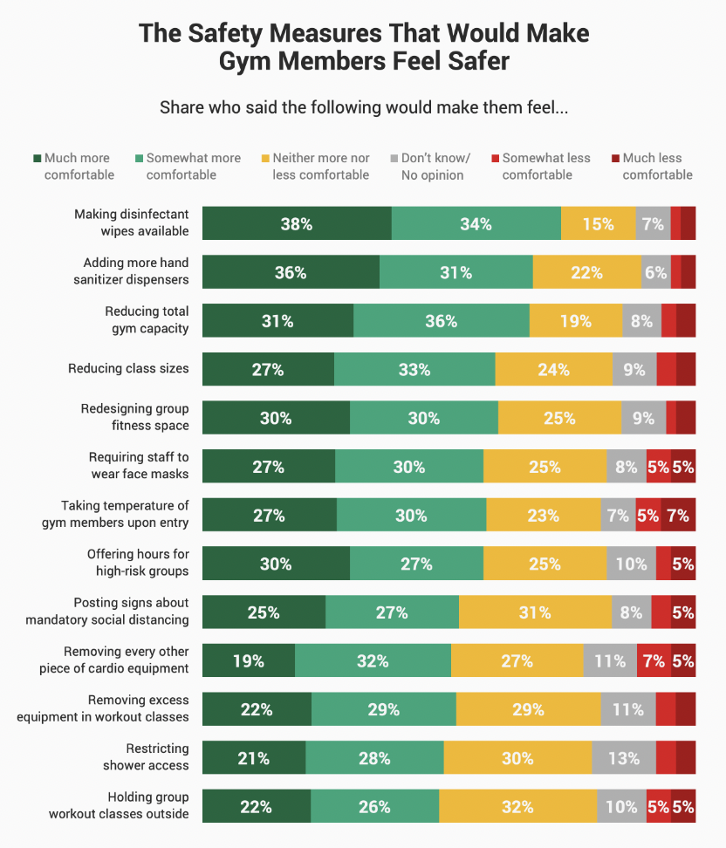
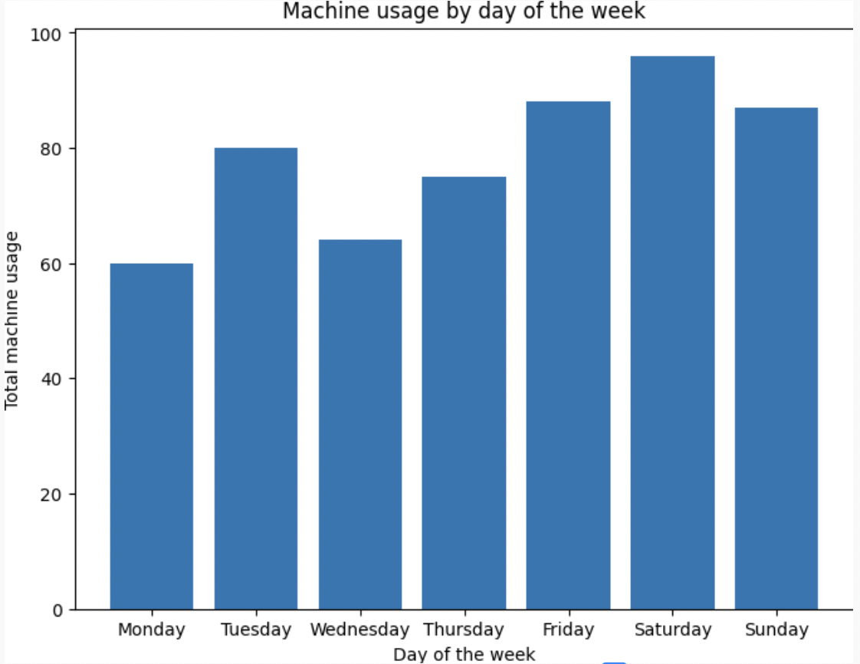
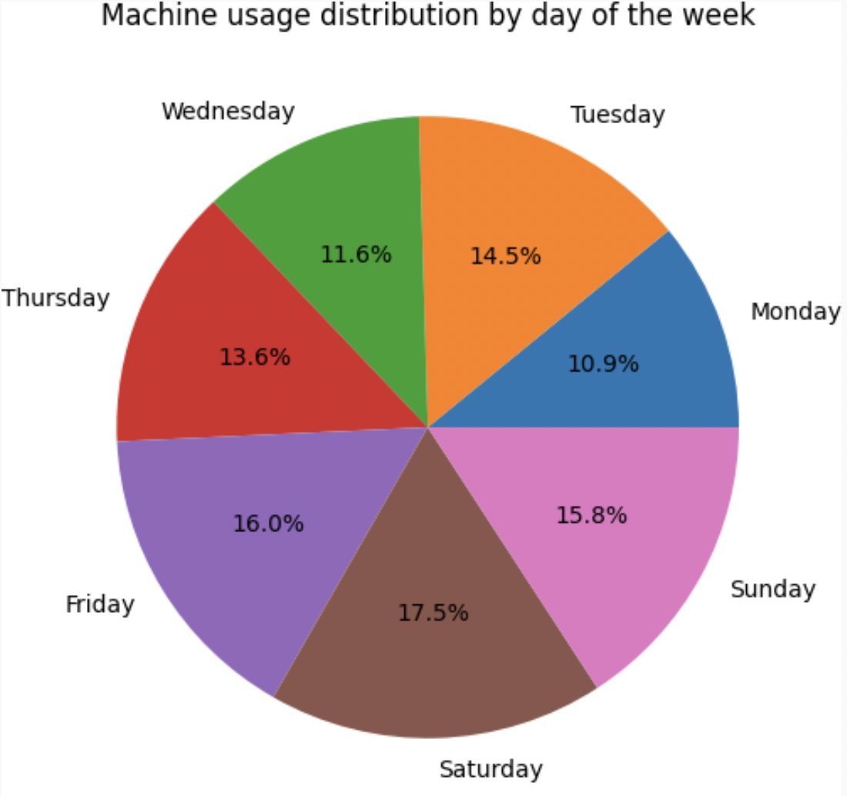
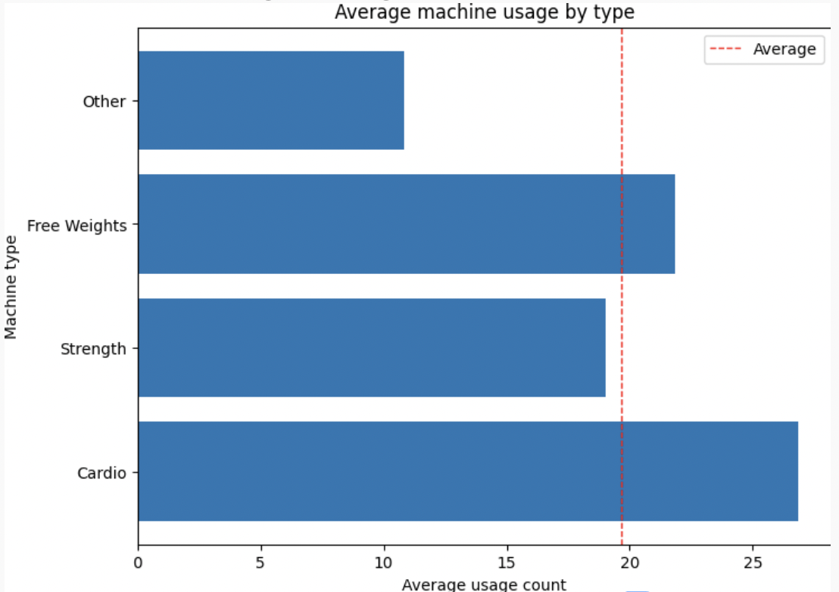
Primary Research Quantified
Notes:
zazi

Slide 19
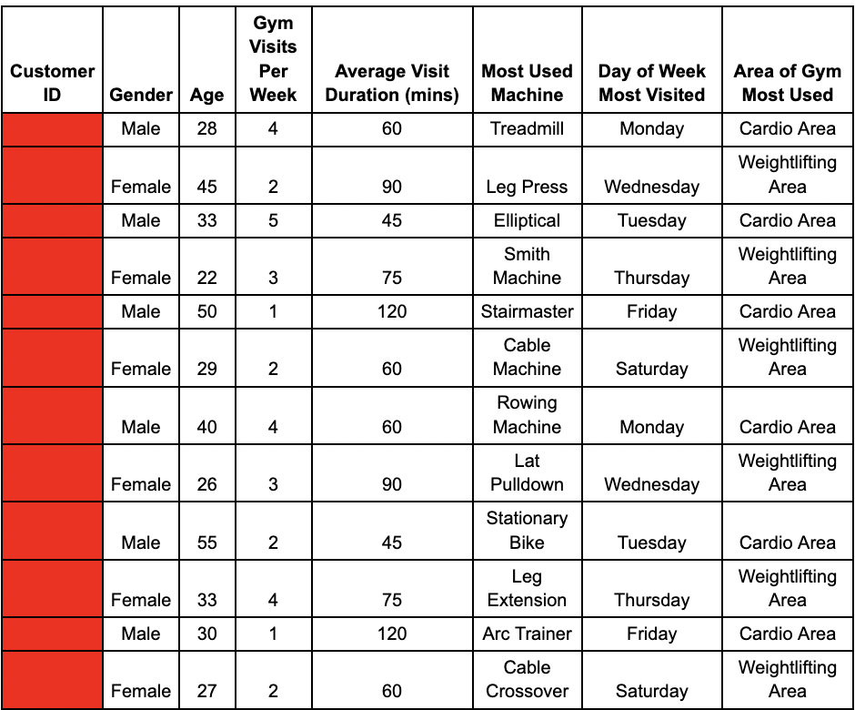

Sample Data Used
Notes:
skip

Slide 20
Primary Research Conclusion
Gym Attendance | Workout Duration | Popular Machines | Busy Areas
Most attend 3-4 times a week Monday, Wednesday, and Friday Drop in attendance on weekends | Avg 1-2 hours Range of workout is vast: 30 min - 3 hours | Cardio machines Weightlifting Little time spent on stretching | Treadmills and weight-lifting areas Locker room and shower areas
HOW DID THIS HELP US?
Notes:
zazi

Slide 21
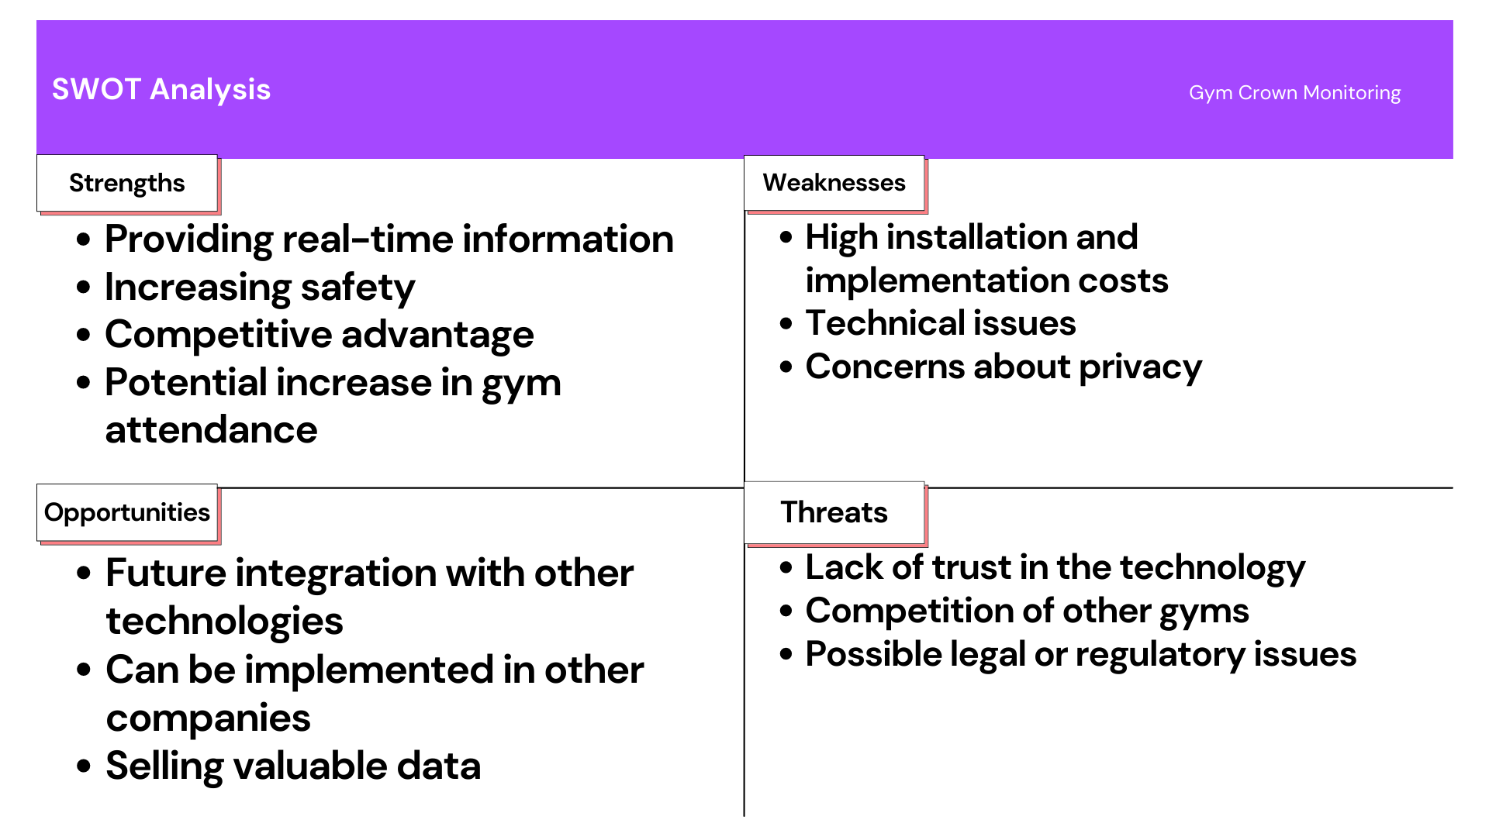
SWOT Analysis
Notes:
electra

Slide 22
SWOT Conclusion and Actions
-Benefits provided to customers that improve their experience
-Project gives opportunities to our company
-Weaknesses may slow us down, but show us our room for improvement
-Threats can help us plan for the future
Notes:
electra

Slide 23
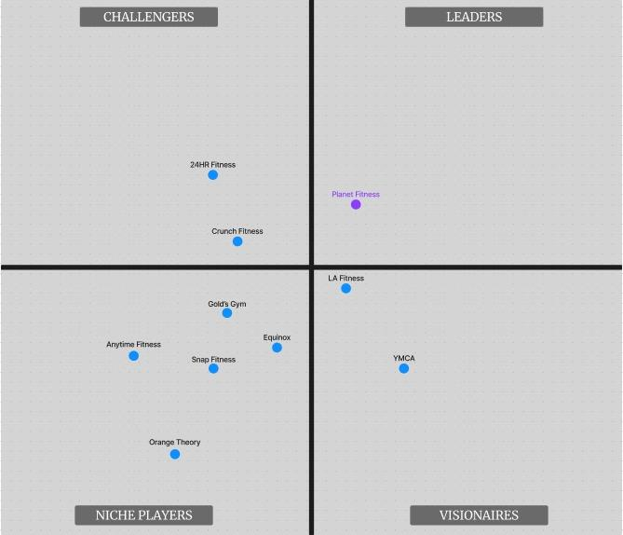
Magic Quadrant
Different Companies Below
Challengers
24HR Fitness
Crunch Fitness
Visionaries
LA Fitness
YMCA
Niche Players
Anytime Fitness
Gold’s Gym
Equinox
Snap Fitness
Orange Theory
Notes:
skip

Slide 24
Magic Quadrant Conclusions and Actions
Shows the Difference between Planet Fitness and the other competitors that
When a company can visibly be seen in the magic quadrant as closing the gap between Planet Fitness and Other companies
Notes:
devan

Slide 25

Ethics, Privacy, and Security
Ethical issues: Potential misuse of data and infringement of privacy
Clear policies and guidelines should be implemented to ensure ethical use of data.
Regular ethics training conducted for all employees involved in the project.
Security risks: Unauthorized access, cyber-attacks
Strong access controls and regular vulnerability assessments
Privacy issues: Risk of data being shared/sold without consent, need to comply with data protection laws.
Clear privacy policies and anonymization techniques to protect gym members' privacy.
Notes:
zazi

Slide 26



Cost of Implementing Ethics, Privacy, and Security
Personnel costs
Training workshops for employees
Technology costs
Access Control: Firewalls, intrusion detection/prevention
Data Management: Additional servers, IAM system
Legal costs (worse scenario)
Unpredictable
Notes:
zazi

Slide 27
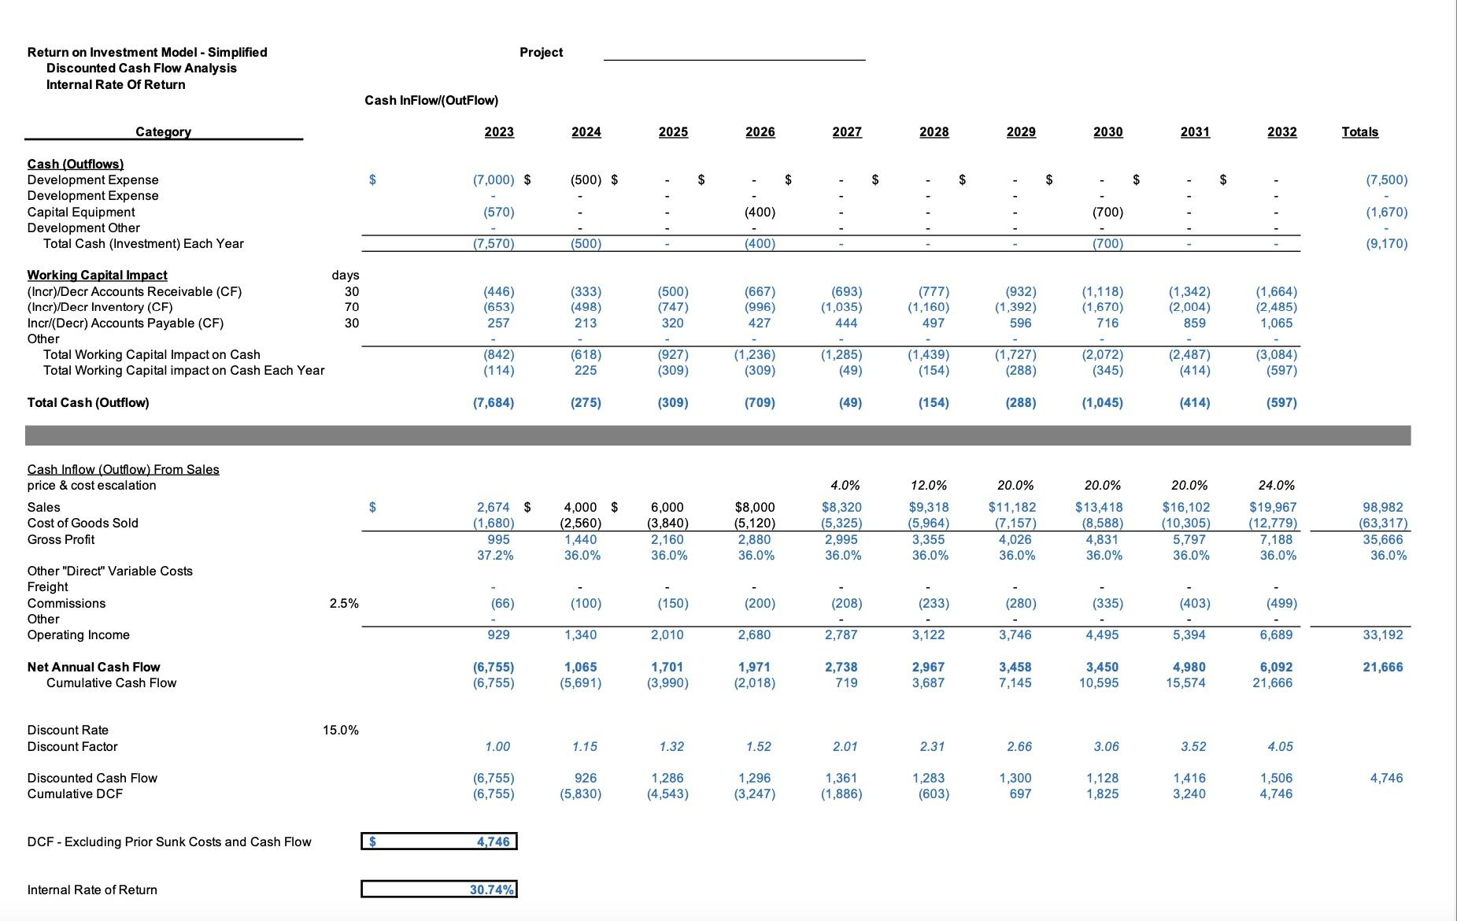
Financials - 10 Year
Notes:
electra

Slide 28
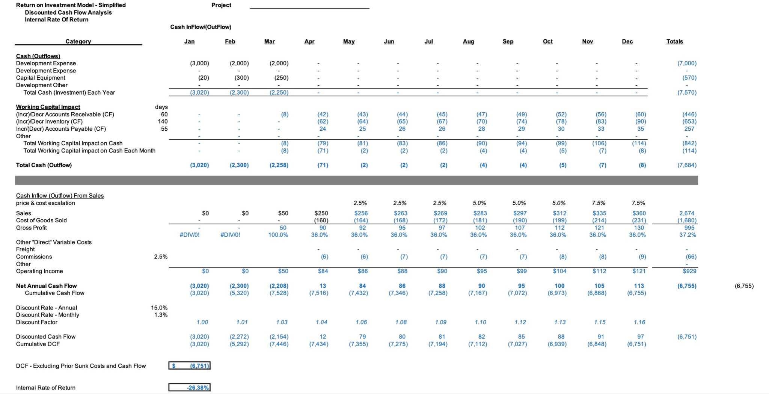
Financial - Monthly
Notes:
electra

Slide 29
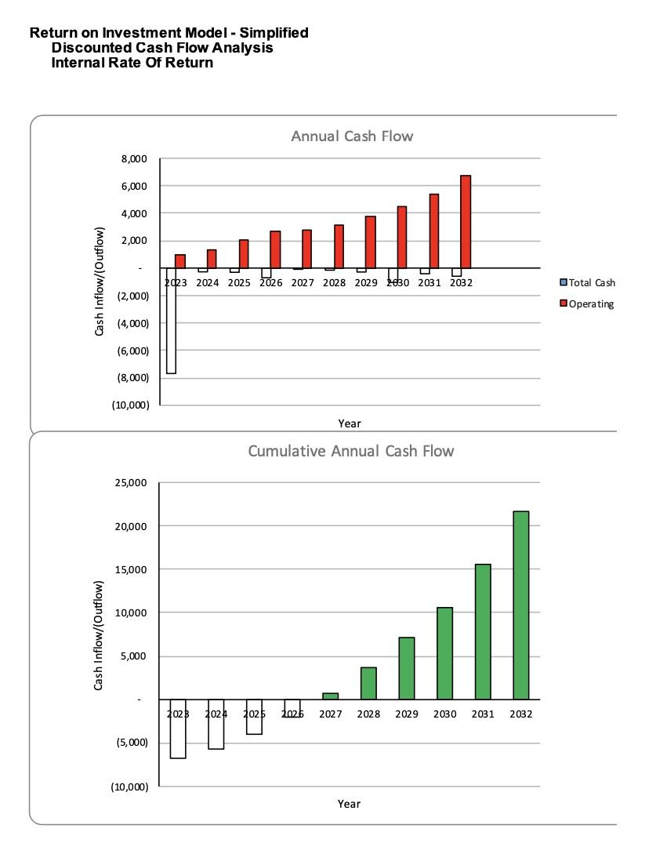
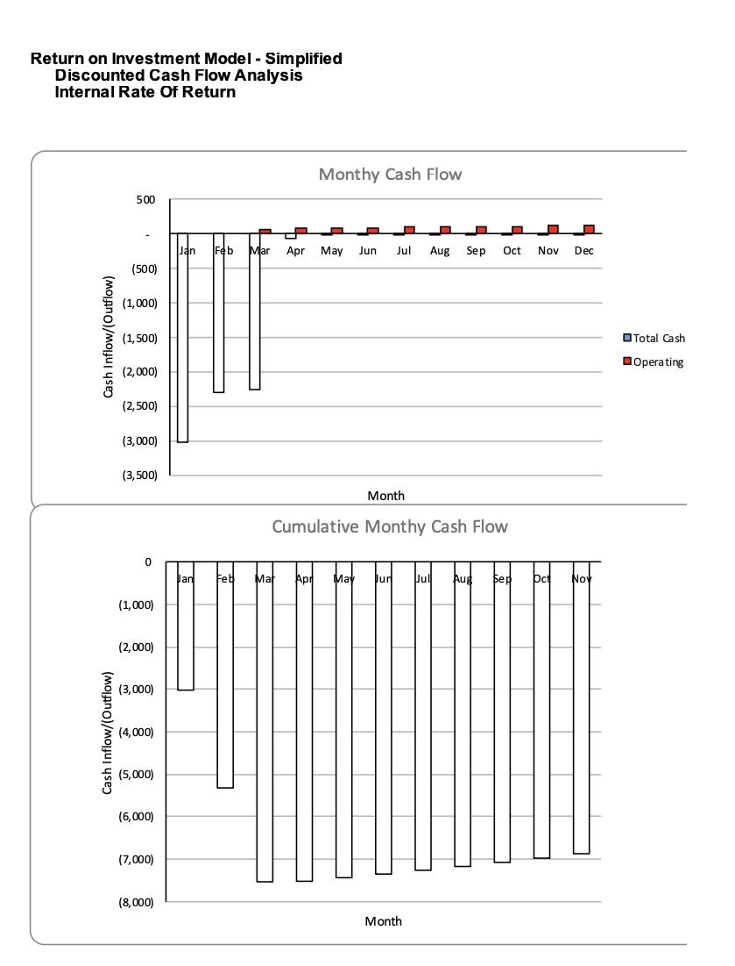
Notes:
electra

Slide 30
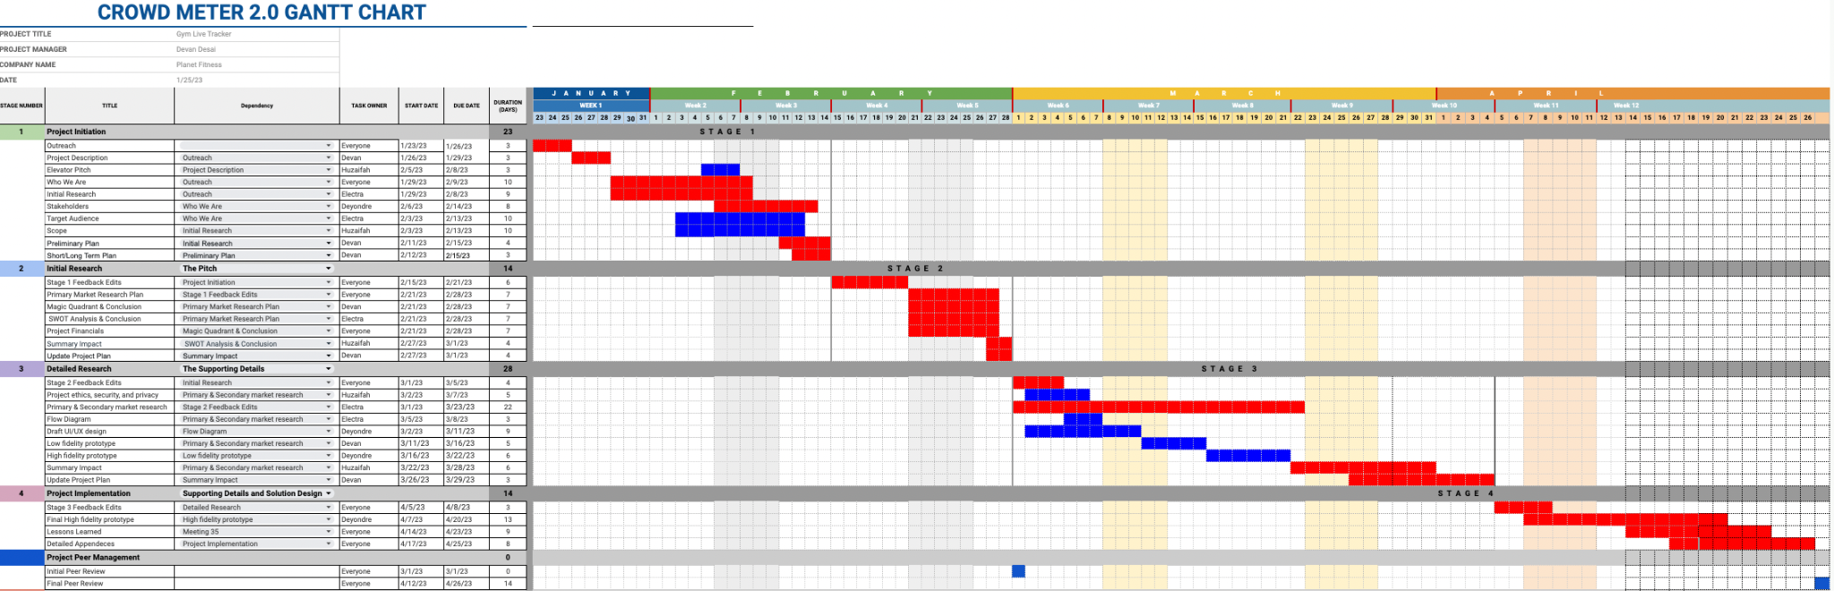
Final Gantt Chart
Stages 1-4 Plans along with Peer Review
Notes:
devan

Slide 31
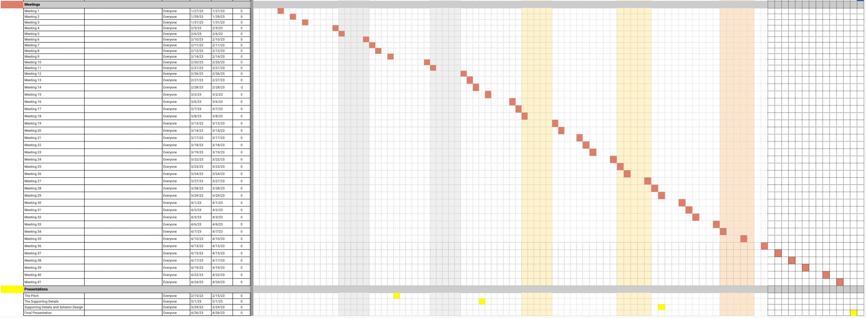
Final Gantt Chart
Meetings and Presentations
Notes:
devan

Slide 32
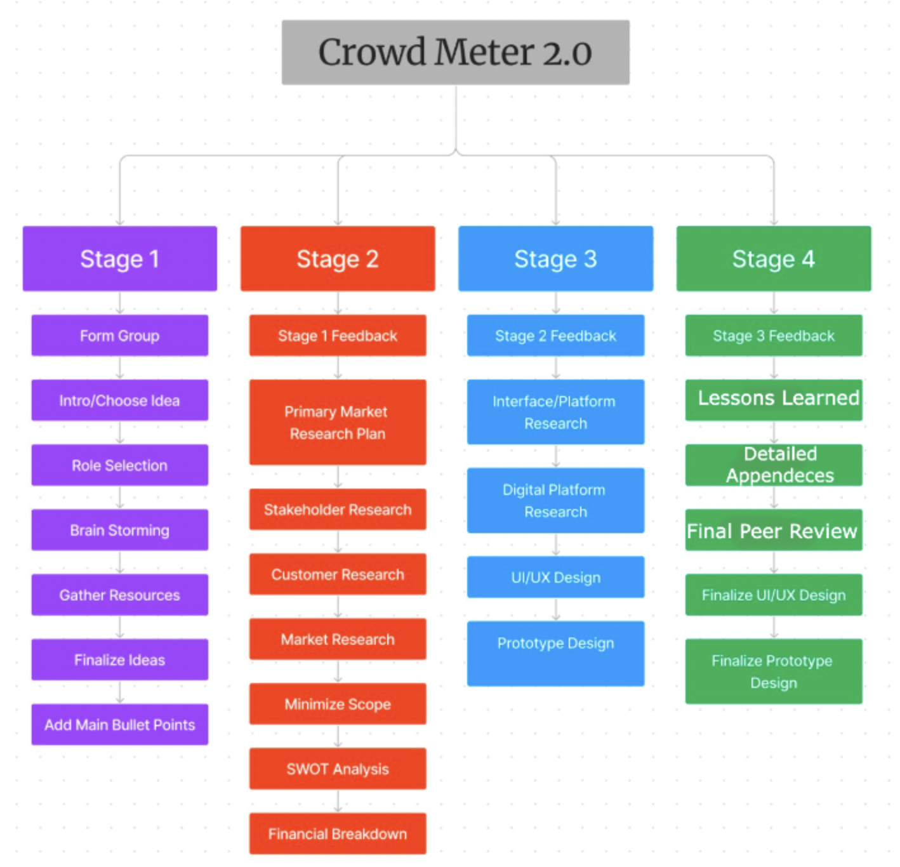
Final Work Breakdown Structure
Notes:
zazi

Slide 33
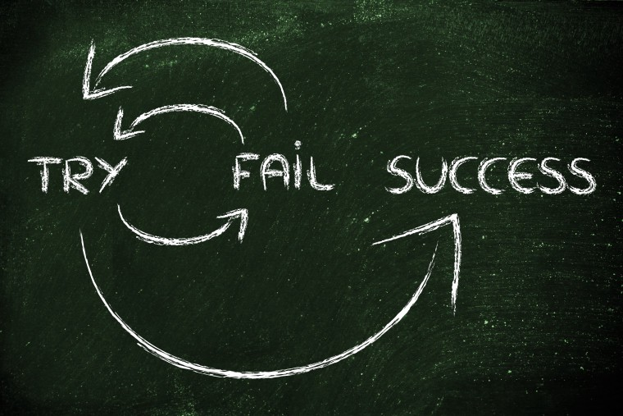

Lessons Learned

Slide 34

Team Dynamics
Member leaving the project
Some roles needed to be re-assigned
Picking up work of other members
Notes:
Zazi

Slide 35


Teamwork vs. Individual work
Self pacing
Meeting deadlines
Tracking changes
Notes:
Devan

Slide 36

Effective Communication
Reaching out to everyone
Setting meeting times
Assigning roles
Notes:
Electra

Slide 37

Planning and Organization
Using Gantt chart to stay organized
Using Gantt chart to set meeting times
Different platforms to communicate
Shared folders and documents
Notes:
Electra

Slide 38
Detailed Appendices
Thomas, J. J., Nelson, J. K., & Silverman, S. J. (2018). An Examination of Demographic, Behavioral, and Situational Predictors of Fitness Center Attendance. Journal of Sport Behavior, 41(3), 298-313.
Aaltonen, S., Leskinen, T., Heinonen, O. J., Kujala, U. M., & Kaprio, J. (2014). Health and fitness clubs–Determinants of attendance and customer satisfaction. Journal of Sports Science & Medicine, 13(4), 767-774.
Prochaska, J. J., Spring, B., & Nigg, C. R. (2008). Multiple health behavior change research: An introduction and overview. Preventive Medicine, 46(3), 181-188.
Nigg, C. R., & Allegrante, J. P. (2016). Reflections from the Intersection of Behavioral Science and the Fitness Industry. Journal of Behavioral Medicine, 39(1), 1-6.
Reaburn, P., & Dascombe, B. (2008). How do we know if athletes are fit? The concept of fitness in athletics. Journal of Science and Medicine in Sport, 11(5), 428-438.
Buman, M. P., Winter, S. J., Sheats, J. L., Hekler, E. B., Otten, J. J., Grieco, L. A., ... & King, A. C. (2016). The Active-At-Work pilot study: a worksite intervention to increase physical activity. American Journal of Preventive Medicine, 50(2), e71-e81.

Slide 39
Detailed Appendices
Carlson, J. A., Sallis, J. F., Conway, T. L., Saelens, B. E., Frank, L. D., Kerr, J., ... & Cain, K. L. (2012). Interactions between psychosocial and built environment factors in explaining older adults' physical activity. Preventive Medicine, 54(1), 68-73.
Dubbert, P. M., Cooper, K. M., Kirchner, K. A., Meydrech, E. F., Bilbrew, D., & Franks, R. D. (2018). Effects of nurse counseling on walking for exercise in elderly primary care patients. The Journals of Gerontology: Series A, 53(5), M314-M319.
Finkelstein, E. A., Trogdon, J. G., Cohen, J. W., & Dietz, W. (2009). Annual medical spending attributable to obesity: payer-and service-specific estimates. Health Affairs, 28(5), w822-w831.
Pescatello, L. S., MacDonald, H. V., Ash, G. I., Lamberti, L., Farquhar, W. B., Arena, R., ... & Johnson, B. T. (2015). Assessing the existing professional exercise recommendations for hypertension: a review and recommendations for future research priorities. Mayo Clinic Proceedings, 90(6), 801-812.from https://www.crunchbase.com/organization/aura-health/company_financials
Nav. (n.d.). Startup Costs: How Much Money Will You Need? Retrieved February 14, 2023, from https://www.nav.com/business-formation/startup-costs/
Nav. (n.d.). The Costs of Starting a Business: A Guide to Understanding Startup Costs. Retrieved February 14, 2023, from https://www.nav.com/business-formation/startup-costs/
Nav. (n.d.). What are Common Business Startup Costs? Retrieved February 14, 2023, from https://www.nav.com/business-formation/startup-costs/

